Slide 1


Computech Corporation: Advanced Job and Candidate Application
Design Specification
Simul Kadakia, Wesley Trescott, Gagandeep Singh
3/10/2015

Slide 2
Contents
Introduction
Assumptions, Constraints, and Standards
Architecture Design
System Design

Slide 3
Introduction
1.

Slide 4
Purpose
Provide a detailed description of the
Design framework
Software and hardware architecture
Security and Communication architecture
Database Design
Use cases
Sequence Diagrams

Slide 5
Definitions, Acronyms, & Abbreviations
• EJCA - Enhanced Job and Candidate Application
• User – Job seeker who uses the application
• Admin – Admin/administrator who manages the users
• Admin portal - Part of the web application that provides special facilities to Admin
• Front End - The part of the application the user interacts with
• Back End – The part of application that manages data and is managed by developers.
• UI – User Interface which is the front end of the application
• Server –Machine that will host the web application as well as database.

Slide 6
Assumptions, Constraints, & Standards
2.

Slide 7
Constraints
UI based on the type of device used
Required modern internet browser such as Safari, Google Chrome, or Internet Explorer.
Assumptions
Internet connection with enough bandwidth (about 1 to 2 mbps)
Internet browser with an up to date JavaScript engine and support for HTTP cookies to remember returning user logins

Slide 8
Architecture Design
3.

Slide 9
Hardware Architecture
Webserver (Owned by Computech)
Windows Server 2008 R2 Standard
16 GB of RAM
Runs the following software:
Microsoft IIS 7.5 Webserver
Microsoft SQL Server 2008 R2 Database
User Machine
Any PC with latest version of Google Chrome or Safari
iPhone 6 and iPad Air running iOS 8.1.3
Samsung Galaxy S5 running Android v5.0 Lollipop

Slide 10
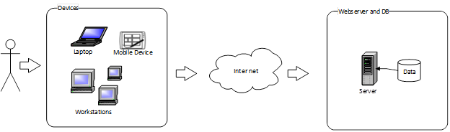
Hardware Architecture

Slide 11
Software Architecture
Microsoft’s ASP.NET MVC design pattern
Models: C# classes
3 self-written user models
Entity Framework C# classes representing db tables
Views: CSHTML files
Individual view file for each web site page, uses Razor syntax
Loaded by controller method associated
Uses Bootstrap CSS and JavaScript, as well as Jquery JavaScript
Controllers: C# classes
Interface and logic between Models and Views
UserController, JobSearchController, HomeController

Slide 12
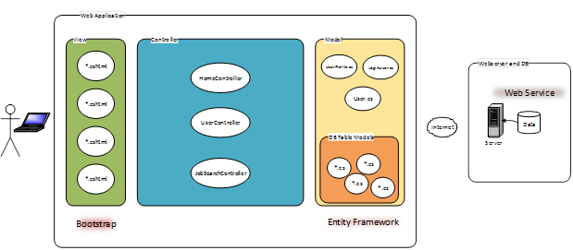
Software Architecture

Slide 13
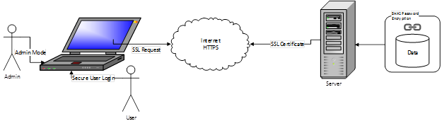
Security Architecture
The web application has the following security features:
Admin mode
SHA1 user password encryption
Login validation
SSL encryption

Slide 14
Communication Architecture
Communication between the different components of the software system (Model, View, and Controller)
C# controller contains a C# model object which it queries for data
Data is then passed to the .CSHTML view, where it is rendered for the user to view
Communication between each of these components is handled via the .NET framework
Communication between the running application on the user’s device and the Computech server
GET (in the case of requesting a web page) and POST (in the case of submitting a form) requests from the user or admin

Slide 15
system Design
4.

Slide 16
System design
Use cases:
Register
Normal Flow: ☺

Slide 17
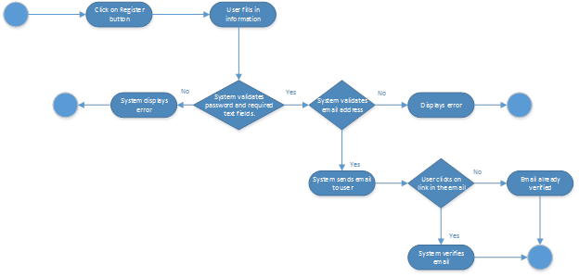
Use case – register - exception

Slide 18
Use case – Login- normal flow ☺

Slide 19
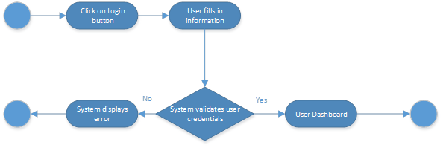
Use case – Login- EXception

Slide 20
Use case – Apply – normal flow ☺

Slide 21
Use case – Apply – exception

Slide 22
Database design

Slide 23
Software Class Diagrams

Slide 24
Level 2 Provides in-depth view of the data flow among the various components of the web application

Slide 25
Level 3-1 Shows the flow of user data in EJCA

Slide 26
Level 3-2 Shows the flow of jobs data in EJCA

Slide 27
User Interface Design
See Document

